Slide 1
MWPPG Update
2024/07/13 By鍾季甫

Slide 2
HealthGather團隊架構
HealthGather
Operating PM
AI Model
Hardware
芮綺
翰陞
旻儒
芮綺
凱峰
旻儒

Slide 3
2class的資料為各項目二分類
4class的資料為血糖4區間
GoogLeNet
VGG16
VisionTransformer
ResNet
VGG19
EfficientNet
SH | 2class | male | train | heatmap | V
 |  |  |  | label | V
 |  |  | test | heatmap | V
 |  |  |  | label | V
 |  | female | train | heatmap | V
 |  |  |  | label | V
 |  |  | test | heatmap | V
 |  |  |  | label | V
 | 4class | male | train | heatmap | V
 |  |  |  | label | V
 |  |  | test | heatmap | V
 |  |  |  | label | V
 |  | female | train | heatmap | V
 |  |  |  | label | V
 |  |  | test | heatmap | V
 |  |  |  | label | V
HKM | 2class | male | train | heatmap | V
 |  |  |  | label | V
 |  |  | test | heatmap | V
 |  |  |  | label | V
 |  | female | train | heatmap | V
 |  |  |  | label | V
 |  |  | test | heatmap | V
 |  |  |  | label | V
 | 4class | male | train | heatmap | V
 |  |  |  | label | V
 |  |  | test | heatmap | V
 |  |  |  | label | V
 |  | female | train | heatmap | V
 |  |  |  | label | V
 |  |  | test | heatmap | V
 |  |  |  | label | V
需獨立於Colab運行

Slide 4
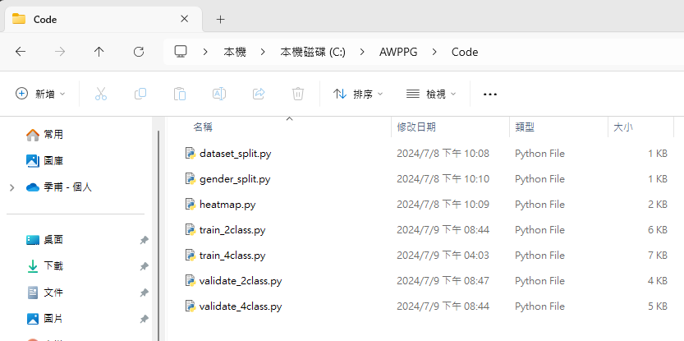
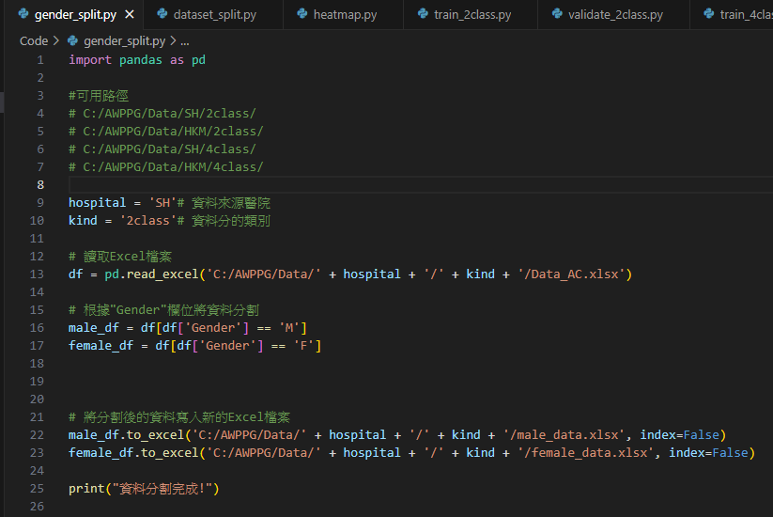
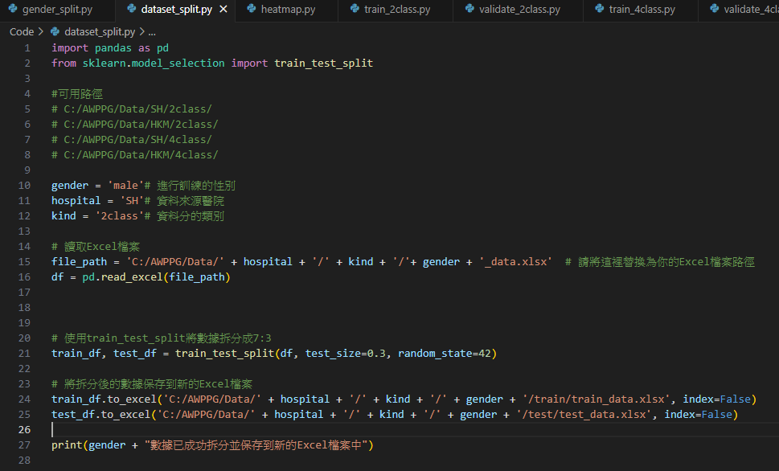
共七份程式碼依序
1.分割訓練&測試集
2.依性別分割資料
3.建立熱力圖
4.2class模型訓練
5.4class模型訓練
6.2class模型評估
7.4class模型評估
分割
訓練集&測試集
預設7:3
依性別分割資料

Slide 5
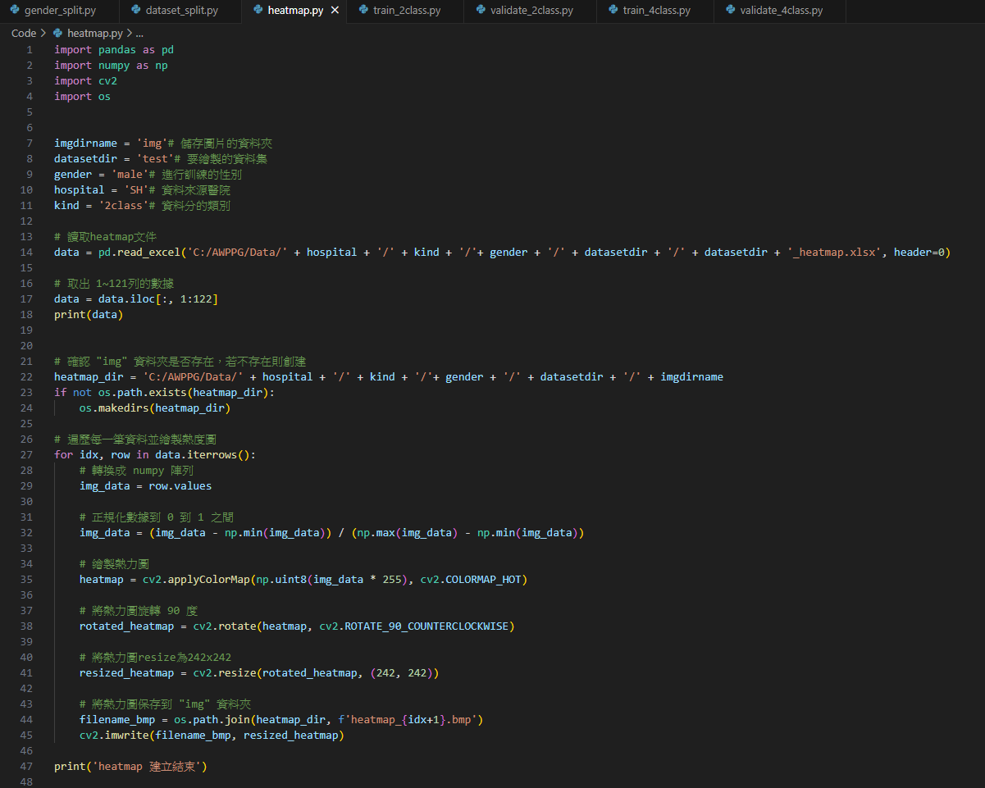
建立熱力圖

Slide 6
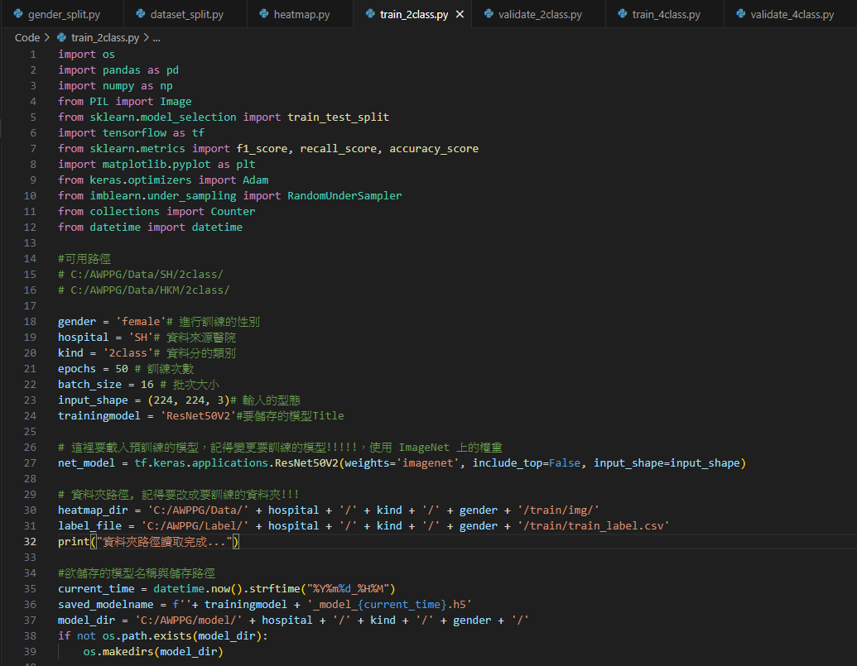
訓練模型

Slide 7
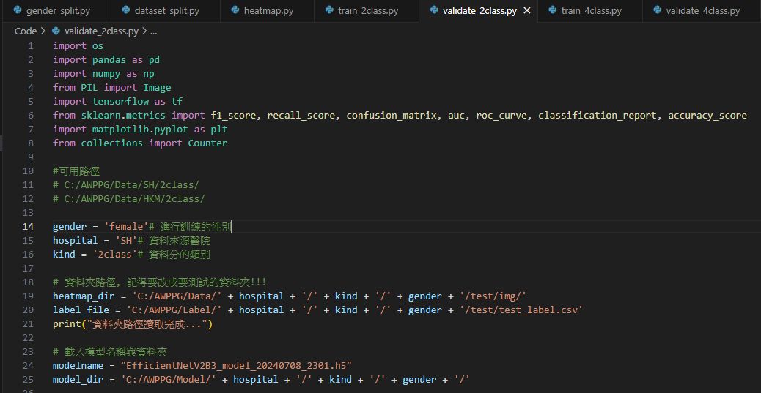
評估模型效能

Slide 8
模型總整理-SH-2class
男性
Model | Accuracy | Precision | Recall | F1-score
GoogLeNet | 0.95 | 0.93 | 0.95 | 0.94
ResNet | 0.95 | 0.93 | 0.96 | 0.94
EfficientNet | 0.67 | 0.33 | 0.50 | 0.40
VGG16 | 0.91 | 0.89 | 0.92 | 0.90
VGG19 | 0.91 | 0.90 | 0.90 | 0.90
Vision Tranformer | 0.67 | 0.33 | 0.96 | 0.40
資料量：訓練&測試比例=7:3
訓練集(各類別比例)
原比例：
男：314:600 女：312:545
平衡後：
男：314:314 女：312:312
測試集(各類別比例)
男：130:263 女：138:230
女性
Model | Accuracy | Precision | Recall | F1-score
GoogLeNet | 0.95 | 0.94 | 0.96 | 0.95
ResNet | 0.96 | 0.97 | 0.96 | 0.96
EfficientNet | 0.62 | 0.31 | 0.50 | 0.38
VGG16 | 0.91 | 0.90 | 0.91 | 0.90
VGG19 | 0.91 | 0.90 | 0.92 | 0.91
Vision Tranformer | 0.68 | 0.65 | 0.65 | 0.65

Slide 9
模型總整理-HKM-2class
男性
Model | Accuracy | Precision | Recall | F1-score
GoogLeNet | 0.95 | 0.95 | 0.99 | 0.97
ResNet | 0.90 | 0.82 | 0.94 | 0.86
EfficientNet | 0.17 | 0.09 | 0.96 | 0.15
VGG16 | 0.91 | 0.83 | 0.95 | 0.87
VGG19 | 0.91 | 0.82 | 0.94 | 0.86
Vision Tranformer | 0.69 | 0.68 | 0.81 | 0.65
資料量：訓練&測試比例=7:3
訓練集(各類別比例)
原比例：
男：163:700 女：74:328
平衡後：
男：163:163 女：74:74
測試集(各類別比例)
男：130:263 女：138:230
女性
Model | Accuracy | Precision | Recall | F1-score
GoogLeNet | 0.99 | 1.00 | 0.98 | 0.99
ResNet | 0.91 | 0.82 | 0.95 | 0.86
EfficientNet | 0.23 | 0.58 | 0.54 | 0.23
VGG16 | 0.99 | 0.97 | 0.99 | 0.98
VGG19 | 1.00 | 1.00 | 1.00 | 1.00
Vision Tranformer | 1.00 | 1.00 | 1.00 | 1.00

Slide 10
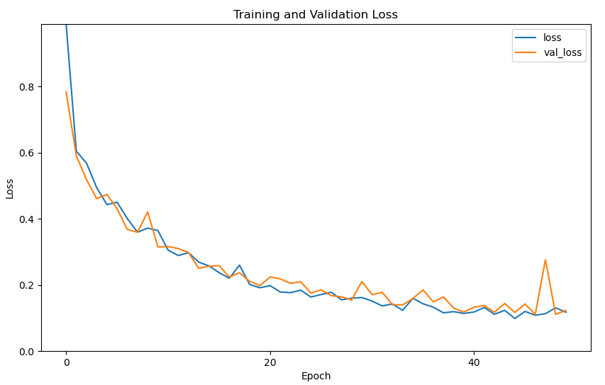
GoogLeNet-SH-2class-Male
F1-Score: 0.9464
Recall: 0.9464
Accuracy: 0.9524

Slide 11
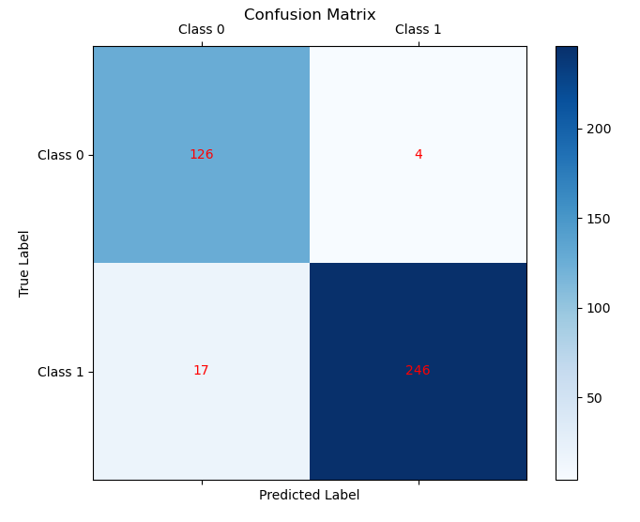
GoogLeNet-SH-2class-Male
 | Precision | Recall | F1-score | Support
Class 0 | 0.88 | 0.97 | 0.92 | 130
Class 1 | 0.98 | 0.94 | 0.96 | 263
Accuracy |  |  | 0.95 | 393
Macro avg | 0.93 | 0.95 | 0.94 | 393
Weighted avg | 0.95 | 0.95 | 0.95 | 393

Slide 12
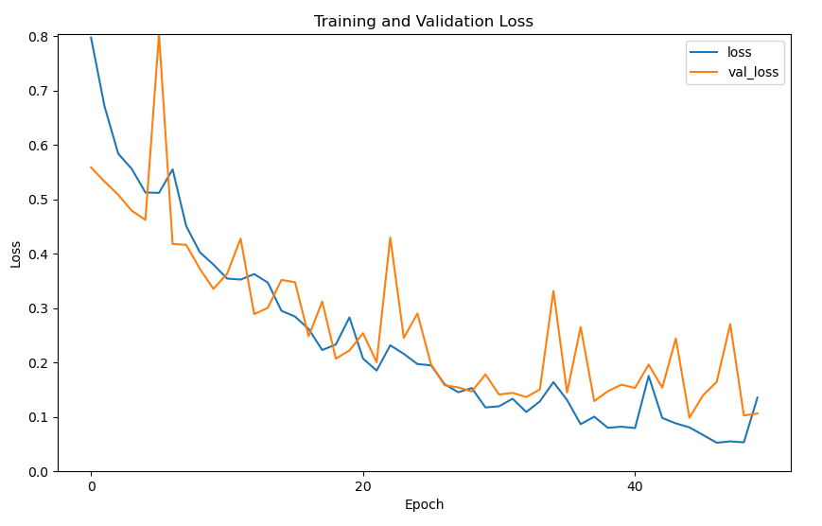
GoogLeNet-SH-2class-Female
F1-Score: 0.9550
Recall: 0.9815
Accuracy: 0.9600

Slide 13
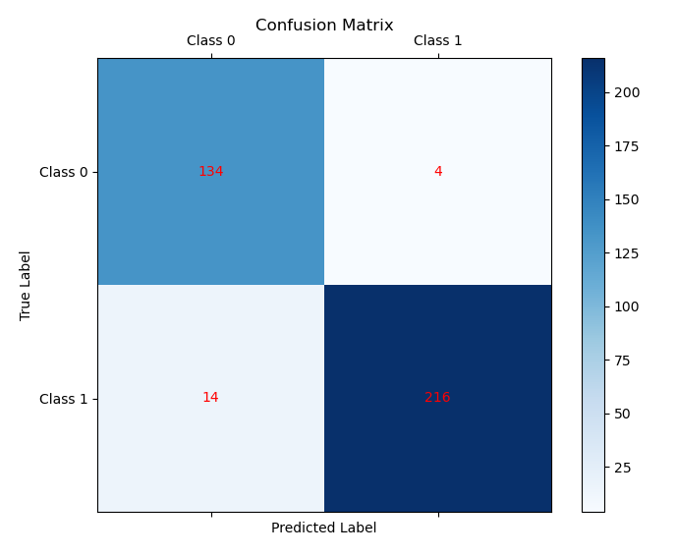
GoogLeNet-SH-2class-Female
 | Precision | Recall | F1-score | Support
Class 0 | 0.91 | 0.97 | 0.94 | 138
Class 1 | 0.98 | 0.94 | 0.96 | 230
Accuracy |  |  | 0.95 | 368
Macro avg | 0.94 | 0.96 | 0.95 | 368
Weighted avg | 0.95 | 0.95 | 0.95 | 368

Slide 14
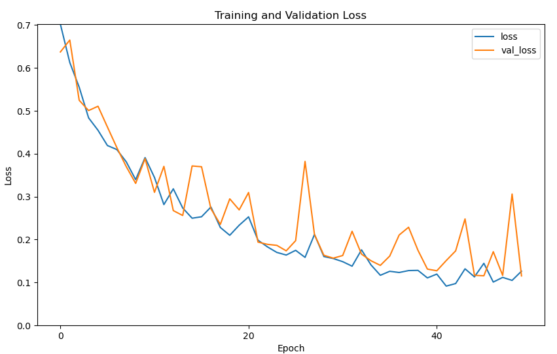
ResNet-SH-2class-Male
F1-Score: 0.9541
Recall: 0.9286
Accuracy: 0.9603

Slide 15
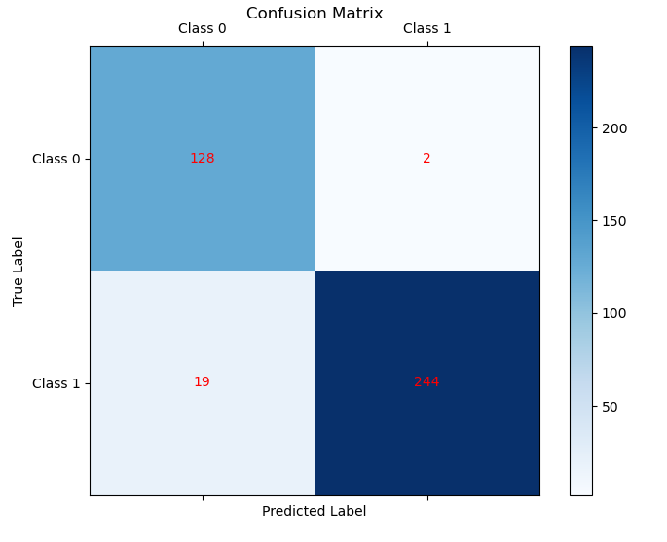
ResNet-SH-2class-Male
 | Precision | Recall | F1-score | Support
Class 0 | 0.87 | 0.98 | 0.92 | 130
Class 1 | 0.99 | 0.93 | 0.96 | 263
Accuracy |  |  | 0.95 | 393
Macro avg | 0.93 | 0.96 | 0.94 | 393
Weighted avg | 0.95 | 0.95 | 0.95 | 393

Slide 16
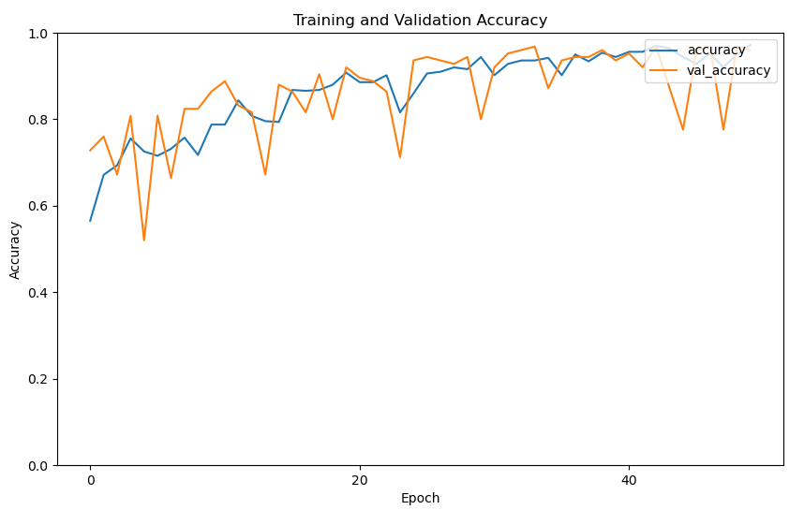
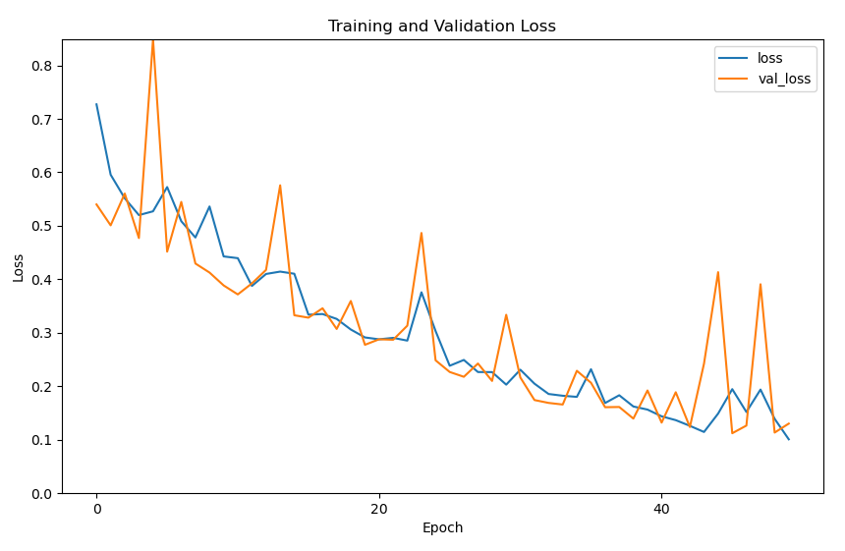
ResNet-SH-2class-Female
F1-Score: 0.9558
Recall: 1.0000
Accuracy: 0.9600

Slide 17
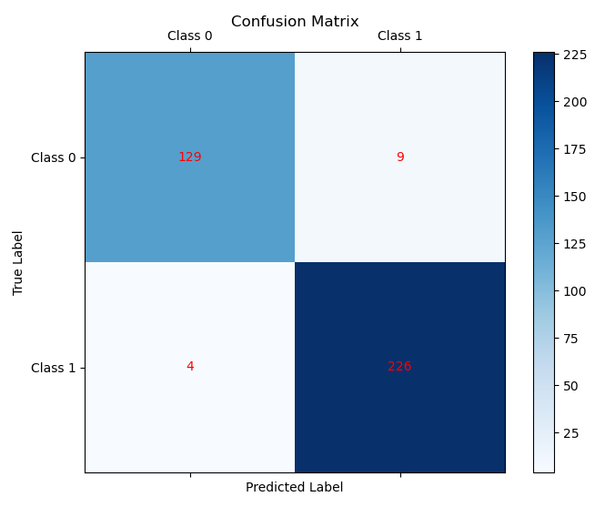
ResNet-SH-2class-Female
 | Precision | Recall | F1-score | Support
Class 0 | 0.97 | 0.93 | 0.95 | 138
Class 1 | 0.96 | 0.98 | 0.97 | 230
Accuracy |  |  | 0.96 | 368
Macro avg | 0.97 | 0.96 | 0.96 | 368
Weighted avg | 0.96 | 0.95 | 0.96 | 368

Slide 18
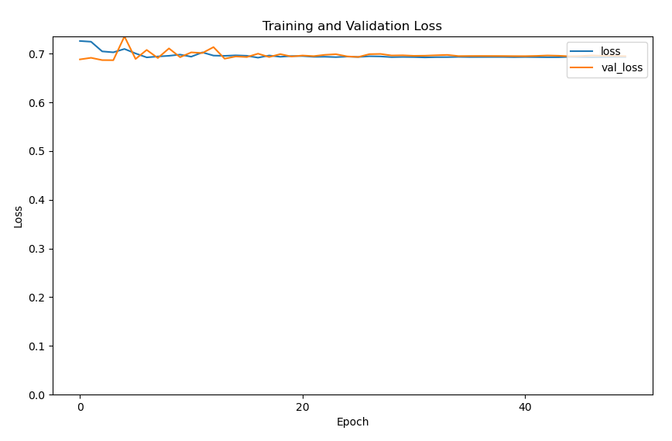
EfficientNet-SH-2class-Male
F1-Score: 0.6154
Recall: 1.0000
Accuracy: 0.4444

Slide 19
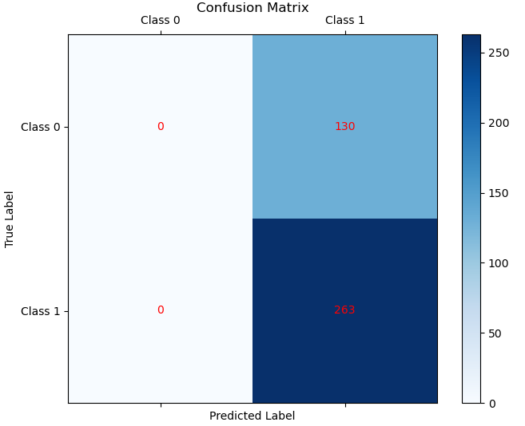
EfficientNet-SH-2class-Male
 | Precision | Recall | F1-score | Support
Class 0 | 0.00 | 0.00 | 0.00 | 130
Class 1 | 0.98 | 0.94 | 0.96 | 263
Accuracy |  |  | 0.67 | 393
Macro avg | 0.33 | 0.50 | 0.40 | 393
Weighted avg | 0.45 | 0.67 | 0.54 | 393

Slide 20
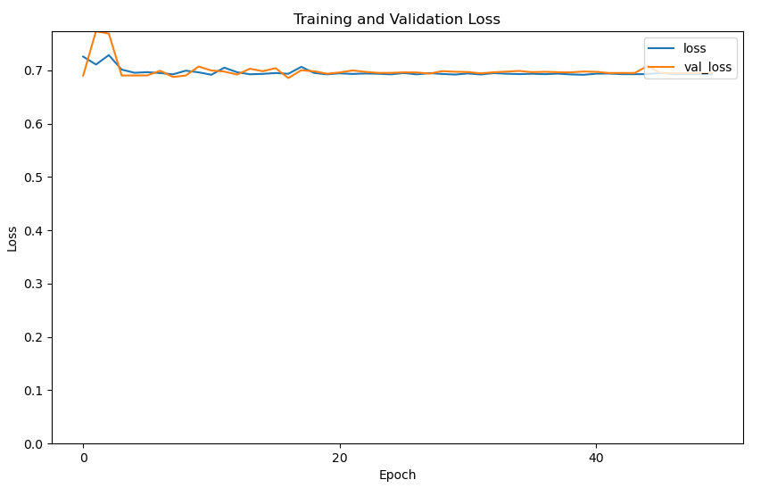
EfficientNet-SH-2class-Female
F1-Score: 0.6034
Recall: 1.0000
Accuracy: 0.4320

Slide 21
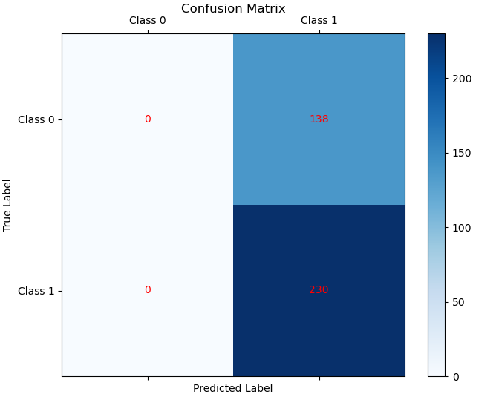
EfficientNet-SH-2class-Female
 | Precision | Recall | F1-score | Support
Class 0 | 0.00 | 0.00 | 0.00 | 138
Class 1 | 0.62 | 1.00 | 0.77 | 230
Accuracy |  |  | 0.62 | 368
Macro avg | 0.31 | 0.50 | 0.38 | 368
Weighted avg | 0.39 | 0.62 | 0.48 | 368

Slide 22
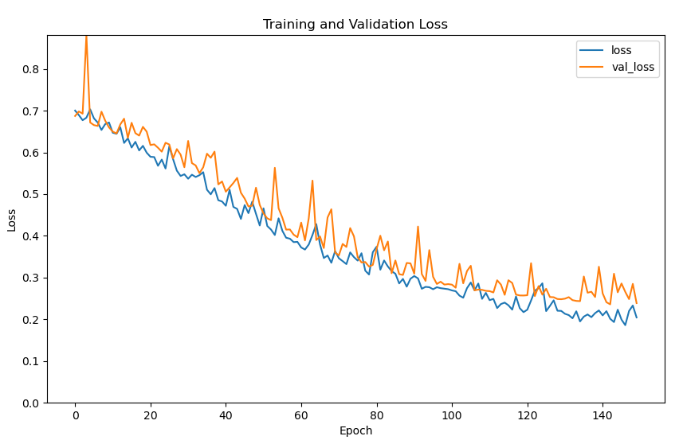
VGG16-SH-2class-Male

Slide 23
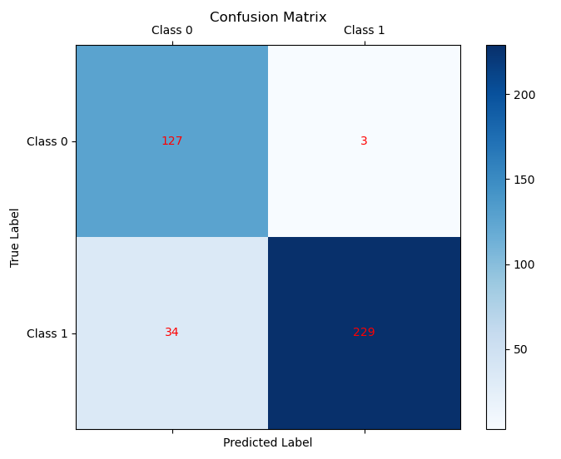
VGG16-SH-2class-Male
 | Precision | Recall | F1-score | Support
Class 0 | 0.79 | 0.98 | 0.87 | 130
Class 1 | 0.99 | 0.94 | 0.93 | 263
Accuracy |  |  | 0.91 | 393
Macro avg | 0.89 | 0.92 | 0.90 | 393
Weighted avg | 0.92 | 0.91 | 0.91 | 393

Slide 24
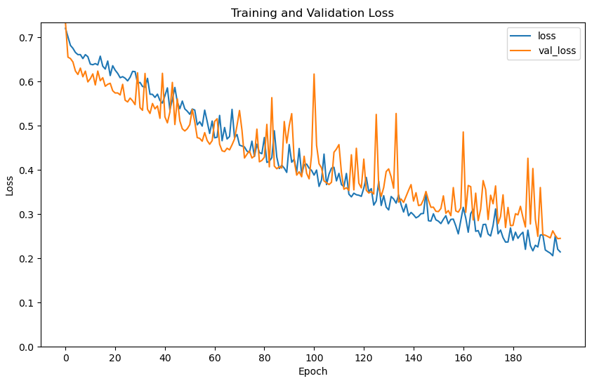
VGG16-SH-2class-Female
F1-Score: 0.8889
Recall: 0.8889
Accuracy: 0.9040

Slide 25
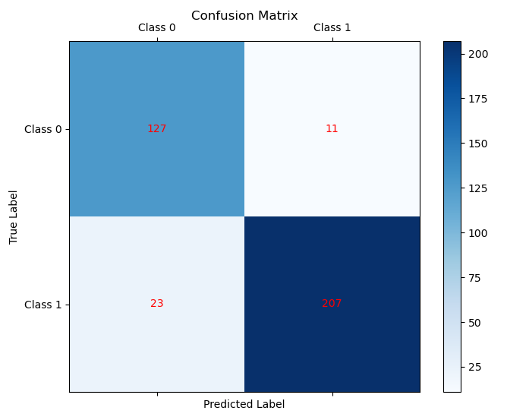
VGG16-SH-2class-Female
 | Precision | Recall | F1-score | Support
Class 0 | 0.85 | 0.92 | 0.88 | 138
Class 1 | 0.95 | 0.90 | 0.92 | 230
Accuracy |  |  | 0.91 | 368
Macro avg | 0.90 | 0.91 | 0.90 | 368
Weighted avg | 0.91 | 0.91 | 0.91 | 368

Slide 26
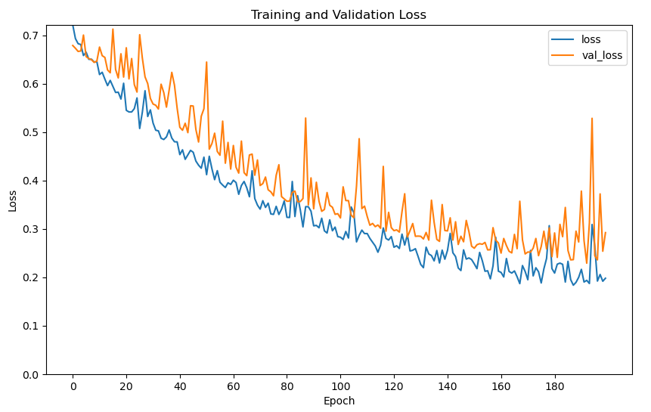
VGG19-SH-2class-Male
F1-Score: 0.8525
Recall: 0.9286
Accuracy: 0.8571

Slide 27
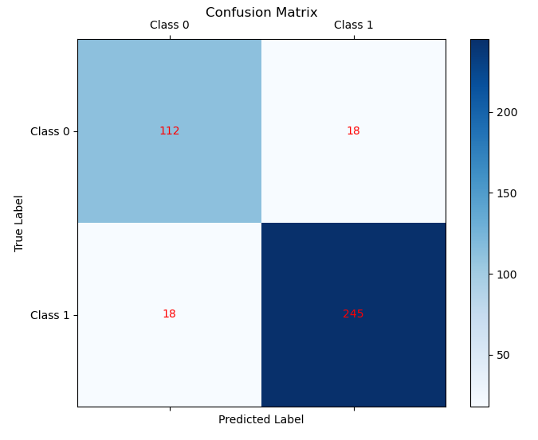
VGG19-SH-2class-Male
 | Precision | Recall | F1-score | Support
Class 0 | 0.86 | 0.86 | 0.86 | 130
Class 1 | 0.93 | 0.93 | 0.93 | 263
Accuracy |  |  | 0.91 | 393
Macro avg | 0.90 | 0.90 | 0.90 | 393
Weighted avg | 0.91 | 0.91 | 0.91 | 393

Slide 28
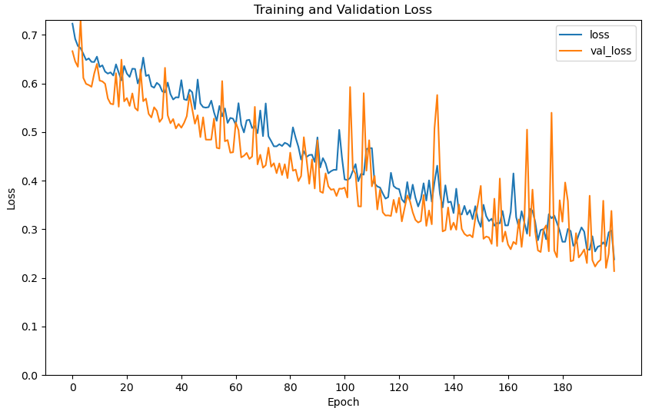
VGG19-SH-2class-Female
F1-Score: 0.9245
Recall: 0.9074
Accuracy: 0.9360

Slide 29
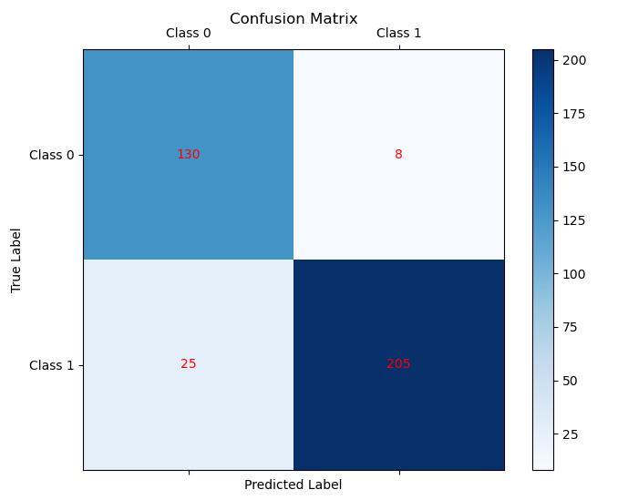
VGG19-SH-2class-Female
 | Precision | Recall | F1-score | Support
Class 0 | 0.84 | 0.94 | 0.89 | 138
Class 1 | 0.96 | 0.89 | 0.93 | 230
Accuracy |  |  | 0.91 | 368
Macro avg | 0.90 | 0.92 | 0.91 | 368
Weighted avg | 0.92 | 0.91 | 0.91 | 368

Slide 30
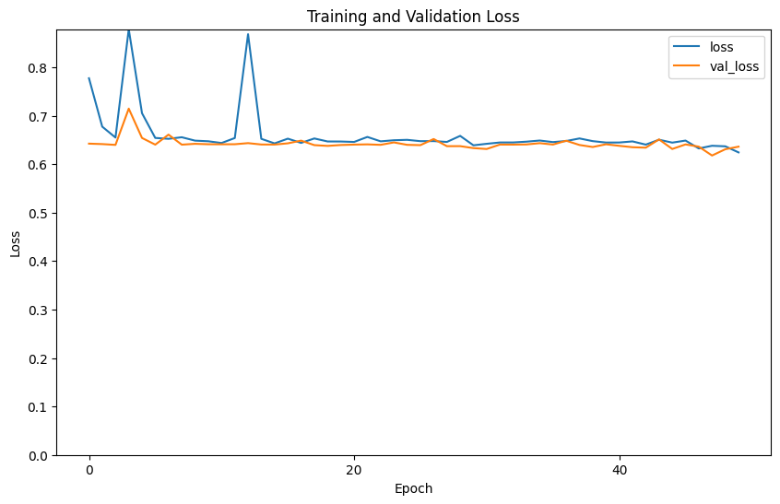
VisionTransformer-SH-2class-Male

Slide 31
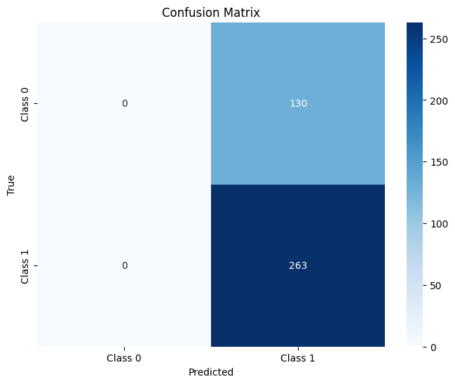
VisionTransformer-SH-2class-Male
 | Precision | Recall | F1-score | Support
Class 0 | 0.00 | 0.00 | 0.00 | 130
Class 1 | 0.67 | 1.00 | 0.80 | 263
Accuracy |  |  | 0.67 | 393
Macro avg | 0.33 | 0.96 | 0.40 | 393
Weighted avg | 0.45 | 0.95 | 0.54 | 393

Slide 32
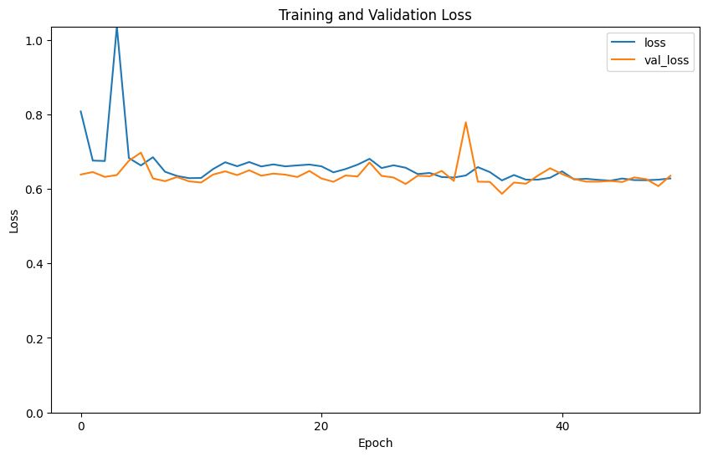
VisionTransformer-SH-2class-Female

Slide 33
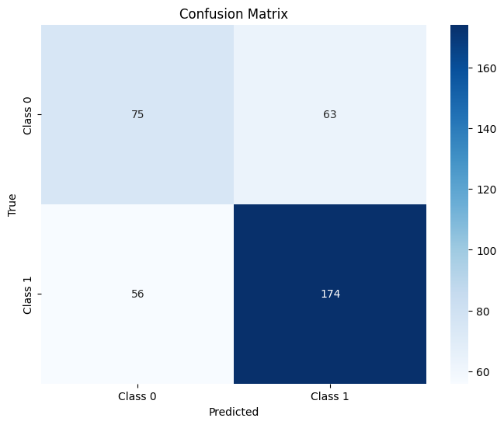
VisionTransformer-SH-2class-Female
 | Precision | Recall | F1-score | Support
Class 0 | 0.57 | 0.54 | 0.56 | 138
Class 1 | 0.73 | 0.76 | 0.75 | 230
Accuracy |  |  | 0.68 | 368
Macro avg | 0.65 | 0.65 | 0.65 | 368
Weighted avg | 0.67 | 0.68 | 0.67 | 368

Slide 34
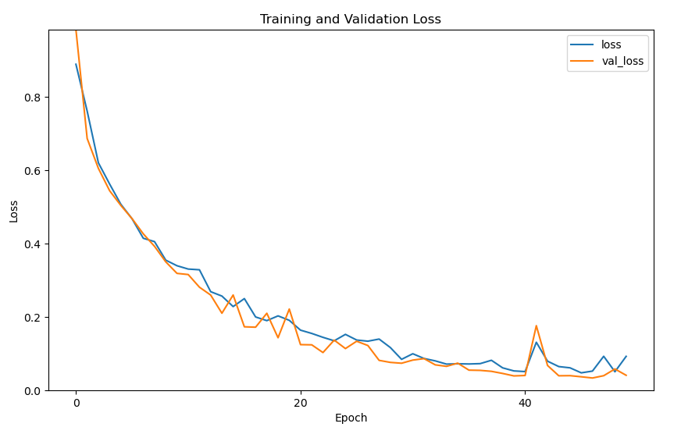
GoogLeNet-HKM-2class-Male
F1-Score: 1.0000
Recall: 1.0000
Accuracy: 1.0000

Slide 35
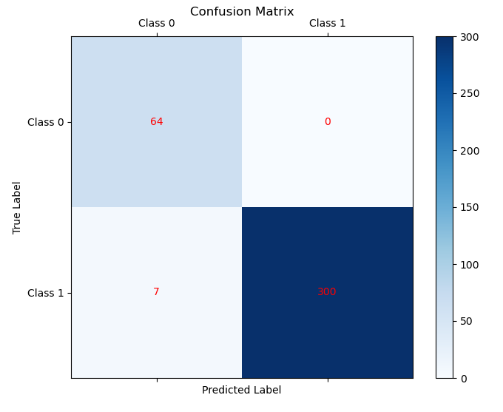
GoogLeNet-HKM-2class-Male
 | Precision | Recall | F1-score | Support
Class 0 | 0.90 | 1.00 | 0.95 | 64
Class 1 | 1.00 | 0.98 | 0.99 | 307
Accuracy |  |  | 0.95 | 371
Macro avg | 0.95 | 0.99 | 0.97 | 371
Weighted avg | 0.98 | 0.98 | 0.98 | 371

Slide 36
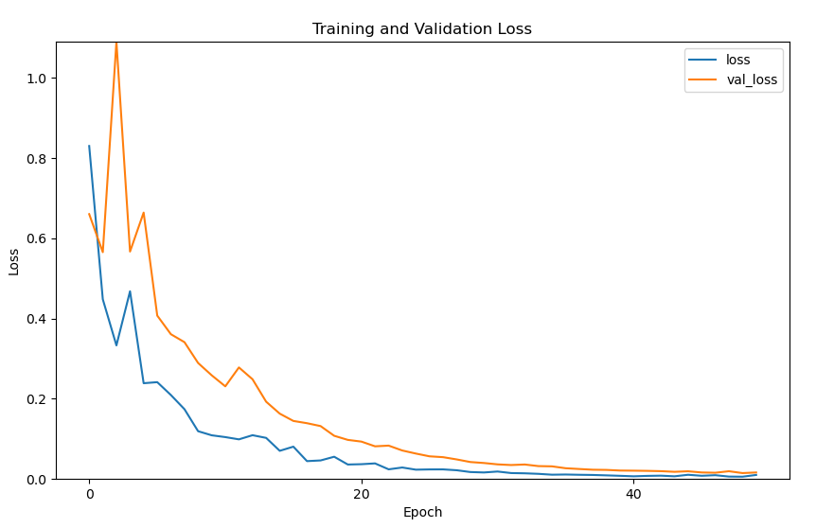
GoogLeNet-HKM-2class-Female
F1-Score: 1.0000
Recall: 1.0000
Accuracy: 1.0000

Slide 37
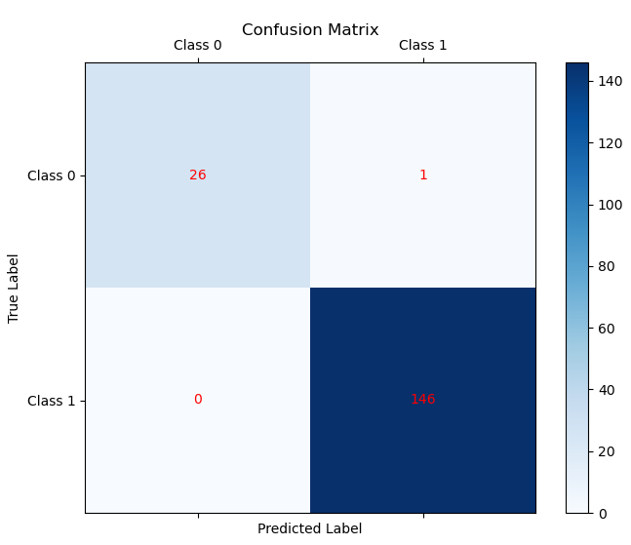
GoogLeNet-HKM-2class-Female
 | Precision | Recall | F1-score | Support
Class 0 | 1.00 | 0.96 | 0.98 | 27
Class 1 | 0.99 | 1.00 | 1.00 | 146
Accuracy |  |  | 0.99 | 173
Macro avg | 1.00 | 0.98 | 0.99 | 173
Weighted avg | 0.99 | 0.99 | 0.99 | 173

Slide 38
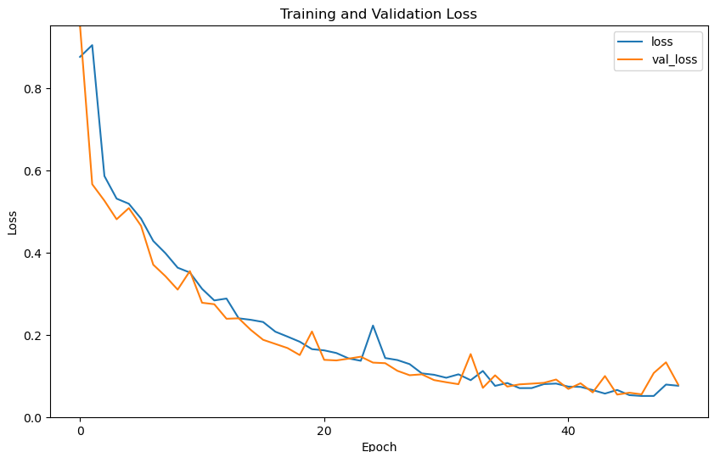
ResNet-HKM-2class-Male
F1-Score: 0.9524
Recall: 0.9091
Accuracy: 0.9545

Slide 39
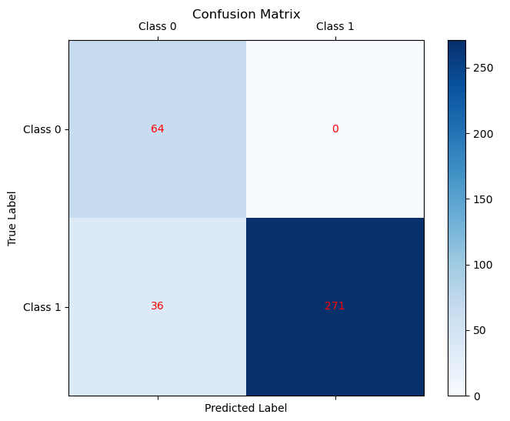
ResNet-HKM-2class-Male
 | Precision | Recall | F1-score | Support
Class 0 | 0.64 | 1.00 | 0.78 | 64
Class 1 | 1.00 | 0.88 | 0.94 | 370
Accuracy |  |  | 0.90 | 371
Macro avg | 0.82 | 0.94 | 0.86 | 371
Weighted avg | 0.94 | 0.90 | 0.91 | 371

Slide 40
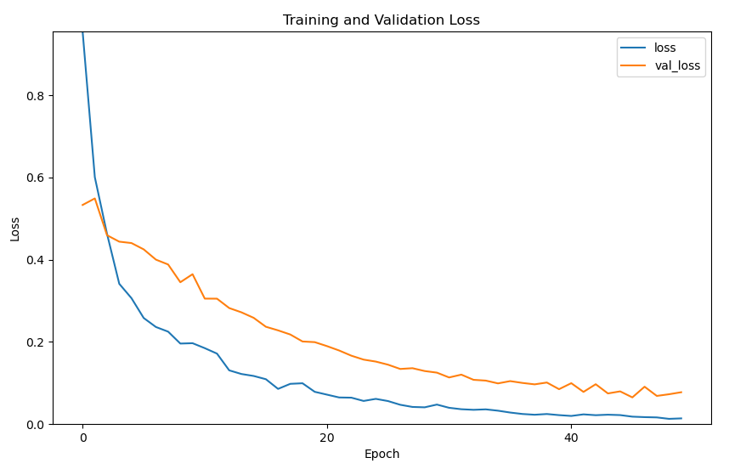
ResNet-HKM-2class-Female

Slide 41
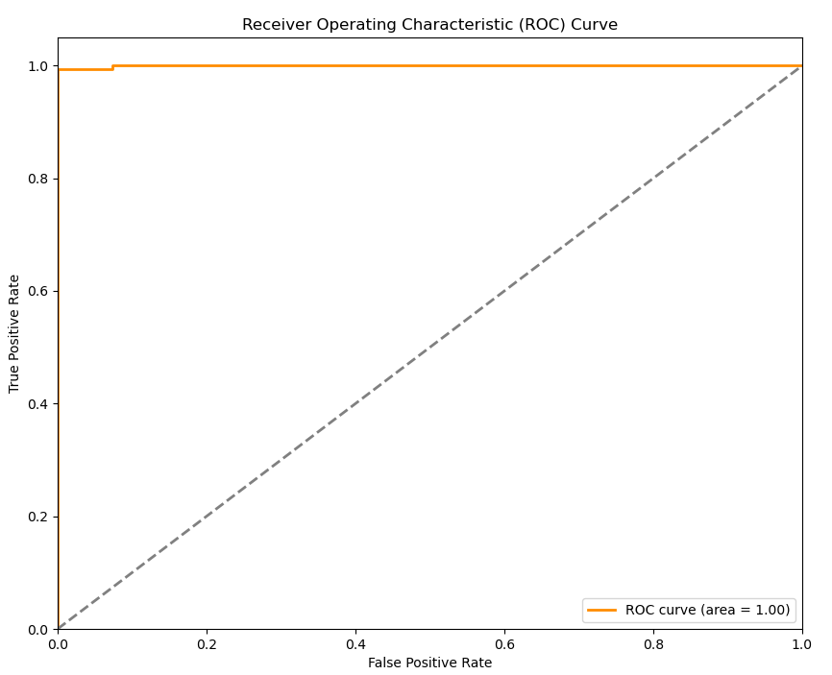
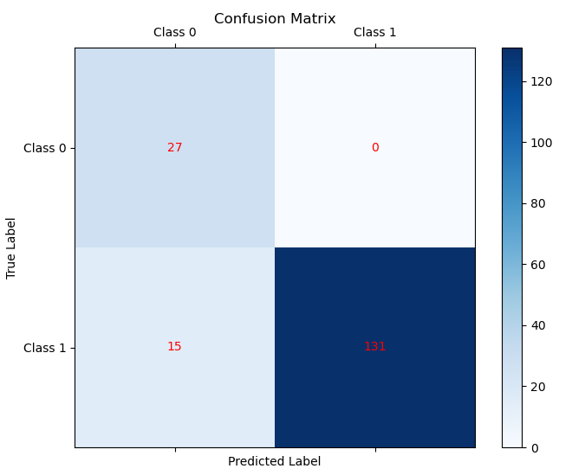
ResNet-HKM-2class-Female
 | Precision | Recall | F1-score | Support
Class 0 | 0.64 | 1.00 | 0.78 | 138
Class 1 | 1.00 | 0.90 | 0.95 | 230
Accuracy |  |  | 0.91 | 368
Macro avg | 0.82 | 0.95 | 0.86 | 368
Weighted avg | 0.94 | 0.91 | 0.92 | 368

Slide 42
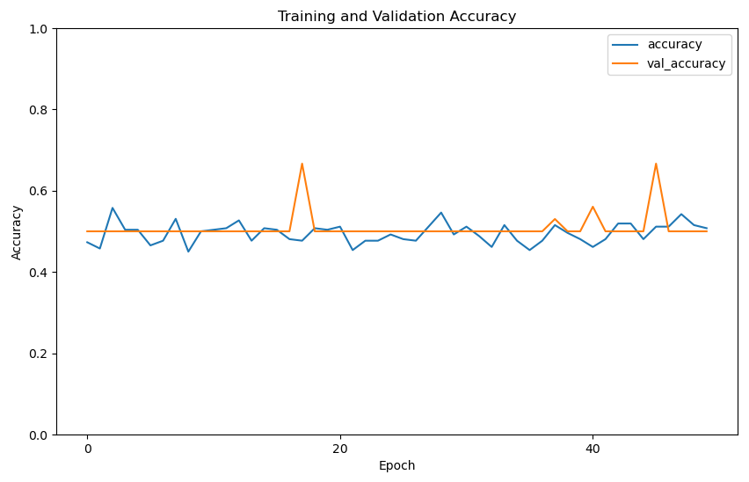
EfficientNet-HKM-2class-Male
F1-Score: 0.0000
Recall: 0.0000
Accuracy: 0.5000

Slide 43
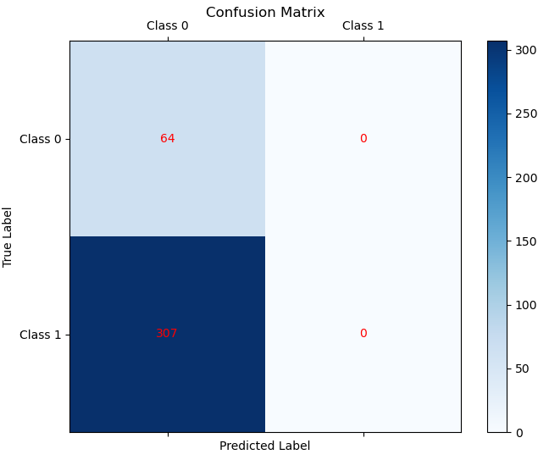
EfficientNet-HKM-2class-Male
 | Precision | Recall | F1-score | Support
Class 0 | 0.17 | 1.00 | 0.29 | 64
Class 1 | 0.00 | 0.00 | 0.00 | 307
Accuracy |  |  | 0.17 | 371
Macro avg | 0.09 | 0.96 | 0.15 | 371
Weighted avg | 0.03 | 0.95 | 0.05 | 371

Slide 44
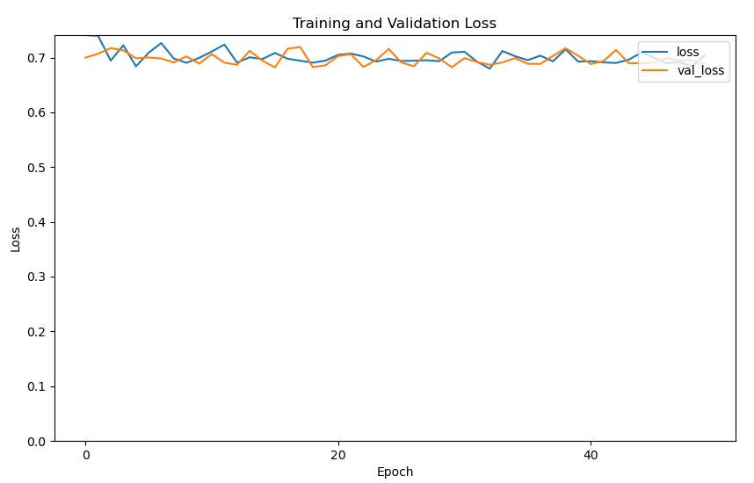
EfficientNet-HKM-2class-Female
F1-Score: 0.0000
Recall: 0.0000
Accuracy: 0.5667

Slide 45
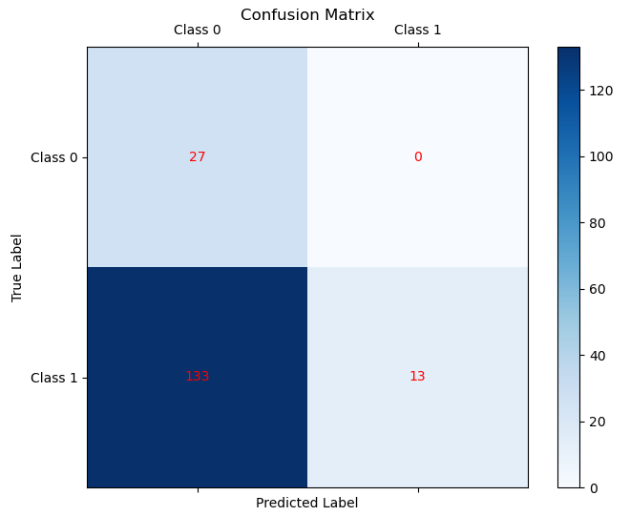
EfficientNet-HKM-2class-Female
 | Precision | Recall | F1-score | Support
Class 0 | 0.17 | 1.00 | 0.29 | 27
Class 1 | 1.00 | 0.09 | 0.16 | 146
Accuracy |  |  | 0.23 | 173
Macro avg | 0.58 | 0.54 | 0.23 | 173
Weighted avg | 0.87 | 0.23 | 0.18 | 173

Slide 46
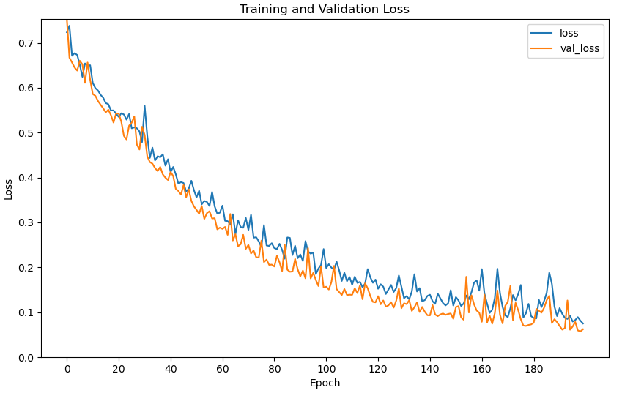
VGG16-HKM-2class-Male
F1-Score: 0.9524
Recall: 0.9091
Accuracy: 0.9545

Slide 47
VGG16-HKM-2class-Male
 | Precision | Recall | F1-score | Support
Class 0 | 0.66 | 1.00 | 0.80 | 64
Class 1 | 1.00 | 0.89 | 0.94 | 307
Accuracy |  |  | 0.91 | 371
Macro avg | 0.83 | 0.95 | 0.87 | 371
Weighted avg | 0.94 | 0.91 | 0.92 | 371

Slide 48
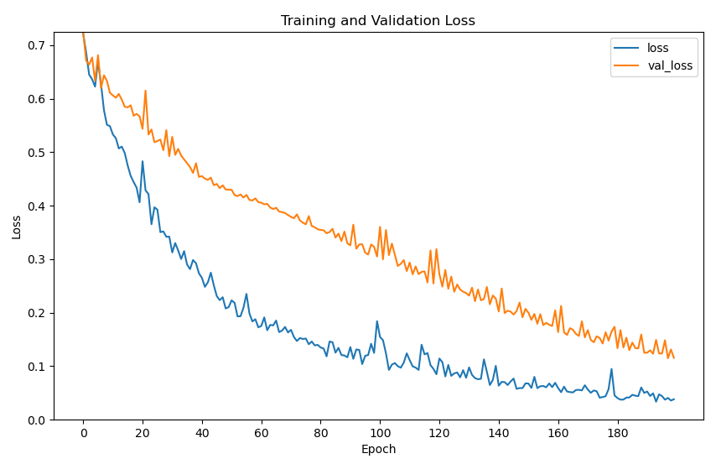
VGG16-HKM-2class-Female
F1-Score: 0.9600
Recall: 0.9231
Accuracy: 0.9667

Slide 49
VGG16-HKM-2class-Female
 | Precision | Recall | F1-score | Support
Class 0 | 0.93 | 1.00 | 0.96 | 27
Class 1 | 1.00 | 0.99 | 0.99 | 146
Accuracy |  |  | 0.99 | 173
Macro avg | 0.97 | 0.99 | 0.98 | 173
Weighted avg | 0.99 | 0.99 | 0.99 | 173

Slide 50
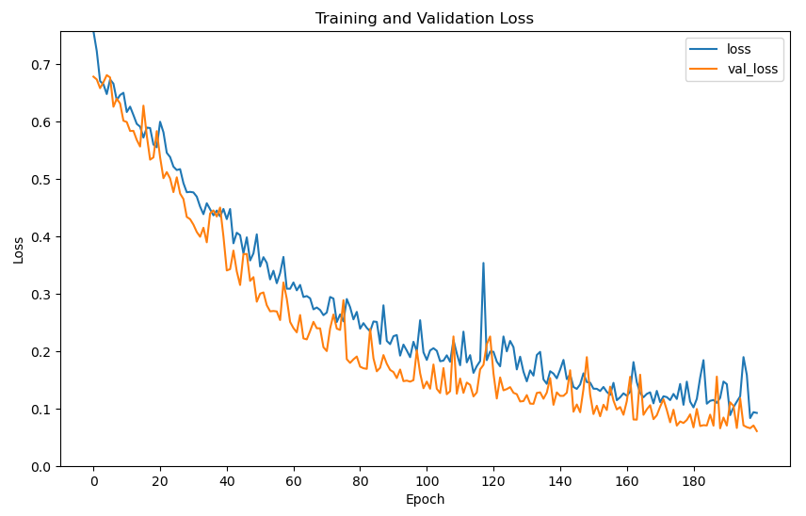
VGG19-HKM-2class-Male
F1-Score: 0.9851
Recall: 1.0000
Accuracy: 0.9848

Slide 51
VGG19-HKM-2class-Male
 | Precision | Recall | F1-score | Support
Class 0 | 0.65 | 1.00 | 0.79 | 64
Class 1 | 1.00 | 0.89 | 0.94 | 307
Accuracy |  |  | 0.91 | 371
Macro avg | 0.82 | 0.94 | 0.86 | 371
Weighted avg | 0.94 | 0.91 | 0.97 | 371

Slide 52
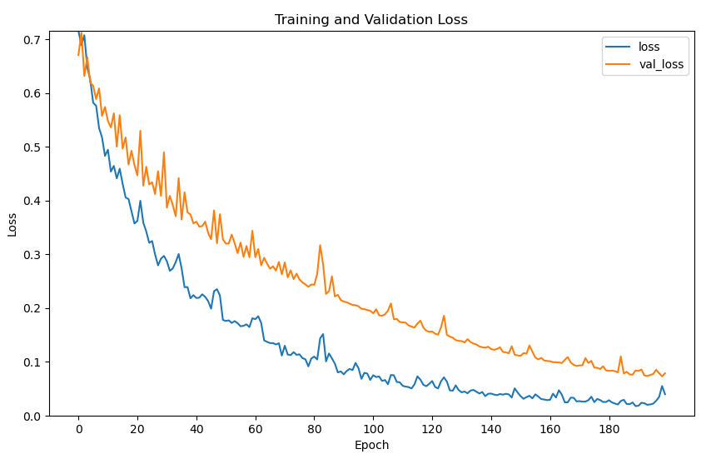
VGG19-HKM-2class-Female
F1-Score: 1.0000
Recall: 1.0000
Accuracy: 1.0000

Slide 53
VGG19-HKM-2class-Female
 | Precision | Recall | F1-score | Support
Class 0 | 1.00 | 1.00 | 1.00 | 27
Class 1 | 1.00 | 1.00 | 1.00 | 146
Accuracy |  |  | 1.00 | 173
Macro avg | 1.00 | 1.00 | 1.00 | 173
Weighted avg | 1.00 | 1.00 | 1.00 | 173

Slide 54
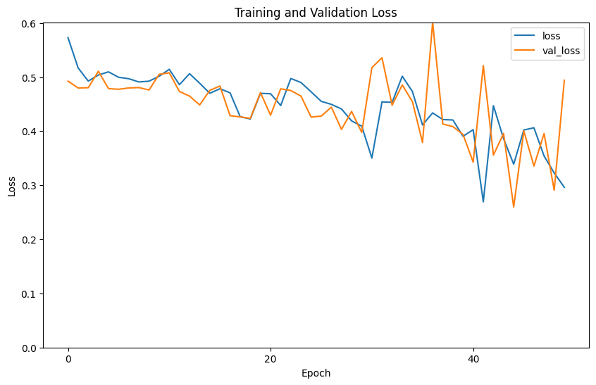
VisionTransformer-HKM-2class-Male

Slide 55
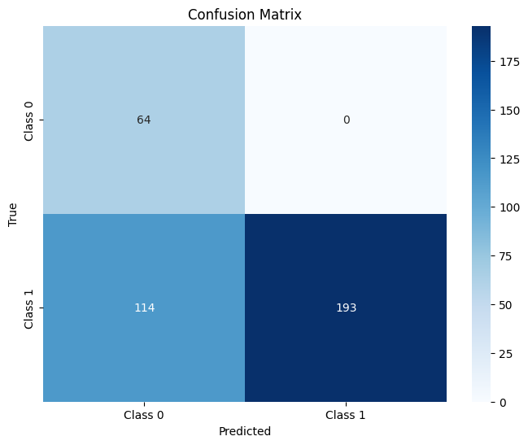
VisionTransformer-HKM-2class-Male
 | Precision | Recall | F1-score | Support
Class 0 | 0.36 | 1.00 | 0.53 | 64
Class 1 | 1.00 | 0.63 | 0.77 | 307
Accuracy |  |  | 0.69 | 371
Macro avg | 0.68 | 0.81 | 0.65 | 371
Weighted avg | 0.89 | 0.69 | 0.73 | 371

Slide 56
VisionTransformer-HKM-2class-Female

Slide 57
VisionTransformer-HKM-2class-Female
 | Precision | Recall | F1-score | Support
Class 0 | 1.00 | 1.00 | 1.00 | 27
Class 1 | 0.98 | 1.00 | 1.00 | 146
Accuracy |  |  | 1.00 | 173
Macro avg | 1.00 | 1.00 | 1.00 | 173
Weighted avg | 1.00 | 1.00 | 1.00 | 173

Slide 58
VGG16-HKM模型於SH測試-2class-Female
 | Precision | Recall | F1-score | Support
Class 0 | 0.16 | 0.06 | 0.09 | 138
Class 1 | 0.59 | 0.82 | 0.69 | 230
Accuracy |  |  | 0.53 | 368
Macro avg | 0.38 | 0.44 | 0.39 | 368
Weighted avg | 0.43 | 0.53 | 0.46 | 368

Slide 59
VGG16-HKM模型於SH測試-2class-male
 | Precision | Recall | F1-score | Support
Class 0 | 0.59 | 0.45 | 0.51 | 130
Class 1 | 0.76 | 0.84 | 0.8 | 263
accuracy |  |  | 0.71 | 393
macro avg | 0.67 | 0.65 | 0.65 | 393
weighted avg | 0.7 | 0.71 | 0.7 | 393

Slide 60
VGG19-HKM模型於SH測試-2class-Female
 | Precision | Recall | F1-score | Support
Class 0 | 0.29 | 0.17 | 0.21 | 138
Class 1 | 0.6 | 0.75 | 0.67 | 230
accuracy |  |  | 0.53 | 368
macro avg | 0.44 | 0.46 | 0.44 | 368
weighted avg | 0.48 | 0.53 | 0.5 | 368

Slide 61
VGG19-HKM模型於SH測試-2class-male
 | Precision | Recall | F1-score | Support
Class 0 | 0.12 | 0.09 | 0.1 | 138
Class 1 | 0.53 | 0.62 | 0.57 | 230
accuracy |  |  | 0.42 | 368
macro avg | 0.32 | 0.35 | 0.34 | 368
weighted avg | 0.38 | 0.42 | 0.39 | 368

Slide 62
GoogLeNet-HKM模型於SH測試-2class-male
 | Precision | Recall | F1-score | Support
Class 0 | 0.16 | 0.06 | 0.09 | 138
Class 1 | 0.59 | 0.82 | 0.69 | 230
Accuracy |  |  | 0.53 | 368
Macro avg | 0.38 | 0.44 | 0.39 | 368
Weighted avg | 0.43 | 0.53 | 0.46 | 368

Slide 63
GoogLeNet-HKM模型於SH測試-2class-Female
 | Precision | Recall | F1-score | Support
Class 0 | 0.16 | 0.06 | 0.09 | 138
Class 1 | 0.59 | 0.82 | 0.69 | 230
Accuracy |  |  | 0.53 | 368
Macro avg | 0.38 | 0.44 | 0.39 | 368
Weighted avg | 0.43 | 0.53 | 0.46 | 368

Slide 64
GoogLeNet-HKM模型於SH測試-2class-male
 | Precision | Recall | F1-score | Support
Class 0 | 0.16 | 0.06 | 0.09 | 138
Class 1 | 0.59 | 0.82 | 0.69 | 230
Accuracy |  |  | 0.53 | 368
Macro avg | 0.38 | 0.44 | 0.39 | 368
Weighted avg | 0.43 | 0.53 | 0.46 | 368

Slide 65
ResNet-HKM模型於SH測試-2class-Female
 | Precision | Recall | F1-score | Support
Class 0 | 0.16 | 0.06 | 0.09 | 138
Class 1 | 0.59 | 0.82 | 0.69 | 230
Accuracy |  |  | 0.53 | 368
Macro avg | 0.38 | 0.44 | 0.39 | 368
Weighted avg | 0.43 | 0.53 | 0.46 | 368

Slide 66
ResNet-HKM模型於SH測試-2class-male
 | Precision | Recall | F1-score | Support
Class 0 | 0.16 | 0.06 | 0.09 | 138
Class 1 | 0.59 | 0.82 | 0.69 | 230
Accuracy |  |  | 0.53 | 368
Macro avg | 0.38 | 0.44 | 0.39 | 368
Weighted avg | 0.43 | 0.53 | 0.46 | 368

Slide 67
EfficientNet-HKM模型於SH測試-2class-Female
 | Precision | Recall | F1-score | Support
Class 0 | 0.16 | 0.06 | 0.09 | 138
Class 1 | 0.59 | 0.82 | 0.69 | 230
Accuracy |  |  | 0.53 | 368
Macro avg | 0.38 | 0.44 | 0.39 | 368
Weighted avg | 0.43 | 0.53 | 0.46 | 368

Slide 68
EfficientNet-HKM模型於SH測試-2class-male
 | Precision | Recall | F1-score | Support
Class 0 | 0.16 | 0.06 | 0.09 | 138
Class 1 | 0.59 | 0.82 | 0.69 | 230
Accuracy |  |  | 0.53 | 368
Macro avg | 0.38 | 0.44 | 0.39 | 368
Weighted avg | 0.43 | 0.53 | 0.46 | 368

Slide 69
ViT-HKM模型於SH測試-2class-Female
 | Precision | Recall | F1-score | Support
Class 0 | 0.16 | 0.06 | 0.09 | 138
Class 1 | 0.59 | 0.82 | 0.69 | 230
Accuracy |  |  | 0.53 | 368
Macro avg | 0.38 | 0.44 | 0.39 | 368
Weighted avg | 0.43 | 0.53 | 0.46 | 368

Slide 70
ViT-HKM模型於SH測試-2class-male
 | Precision | Recall | F1-score | Support
Class 0 | 0.16 | 0.06 | 0.09 | 138
Class 1 | 0.59 | 0.82 | 0.69 | 230
Accuracy |  |  | 0.53 | 368
Macro avg | 0.38 | 0.44 | 0.39 | 368
Weighted avg | 0.43 | 0.53 | 0.46 | 368

Slide 71
GoogLeNet-SH-4class-Male
 | Precision | Recall | F1-score | Support
Class 0 | 0.16 | 0.06 | 0.09 | 138
Class 1 | 0.59 | 0.82 | 0.69 | 230
Accuracy |  |  | 0.53 | 368
Macro avg | 0.38 | 0.44 | 0.39 | 368
Weighted avg | 0.43 | 0.53 | 0.46 | 368

Slide 72
GoogLeNet-SH-4class-Male
 | Precision | Recall | F1-score | Support
Class 0 | 0.88 | 0.97 | 0.92 | 130
Class 1 | 0.98 | 0.94 | 0.96 | 263
Accuracy |  |  | 0.95 | 393
Macro avg | 0.93 | 0.95 | 0.94 | 393
Weighted avg | 0.95 | 0.95 | 0.95 | 393

Slide 73
GoogLeNet-SH-4class-Female

Slide 74
GoogLeNet-SH-4class-Female
 | Precision | Recall | F1-score | Support
Class 0 | 0.91 | 0.97 | 0.94 | 138
Class 1 | 0.98 | 0.94 | 0.96 | 230
Accuracy |  |  | 0.95 | 368
Macro avg | 0.94 | 0.96 | 0.95 | 368
Weighted avg | 0.95 | 0.95 | 0.95 | 368

Slide 75
ResNet-SH-4class-Male

Slide 76
ResNet-SH-4class-Male
 | Precision | Recall | F1-score | Support
Class 0 | 0.91 | 0.97 | 0.94 | 138
Class 1 | 0.98 | 0.94 | 0.96 | 230
Accuracy |  |  | 0.95 | 368
Macro avg | 0.94 | 0.96 | 0.95 | 368
Weighted avg | 0.95 | 0.95 | 0.95 | 368

Slide 77
ResNet-SH-4class-Female

Slide 78
ResNet-SH-4class-Female
 | Precision | Recall | F1-score | Support
Class 0 | 0.91 | 0.97 | 0.94 | 138
Class 1 | 0.98 | 0.94 | 0.96 | 230
Accuracy |  |  | 0.95 | 368
Macro avg | 0.94 | 0.96 | 0.95 | 368
Weighted avg | 0.95 | 0.95 | 0.95 | 368

Slide 79
EfficientNet-SH-4class-Male

Slide 80
EfficientNet-SH-4class-Male
 | Precision | Recall | F1-score | Support
Class 0 | 0.91 | 0.97 | 0.94 | 138
Class 1 | 0.98 | 0.94 | 0.96 | 230
Accuracy |  |  | 0.95 | 368
Macro avg | 0.94 | 0.96 | 0.95 | 368
Weighted avg | 0.95 | 0.95 | 0.95 | 368

Slide 81
EfficientNet-SH-4class-Female

Slide 82
EfficientNet-SH-4class-Female
 | Precision | Recall | F1-score | Support
Class 0 | 0.91 | 0.97 | 0.94 | 138
Class 1 | 0.98 | 0.94 | 0.96 | 230
Accuracy |  |  | 0.95 | 368
Macro avg | 0.94 | 0.96 | 0.95 | 368
Weighted avg | 0.95 | 0.95 | 0.95 | 368

Slide 83
VGG16-SH-4class-Male

Slide 84
VGG16-SH-4class-Male
 | Precision | Recall | F1-score | Support
Class 0 | 0.91 | 0.97 | 0.94 | 138
Class 1 | 0.98 | 0.94 | 0.96 | 230
Accuracy |  |  | 0.95 | 368
Macro avg | 0.94 | 0.96 | 0.95 | 368
Weighted avg | 0.95 | 0.95 | 0.95 | 368

Slide 85
VGG16-SH-4class-Female

Slide 86
VGG16-SH-4class-Female
 | Precision | Recall | F1-score | Support
Class 0 | 0.91 | 0.97 | 0.94 | 138
Class 1 | 0.98 | 0.94 | 0.96 | 230
Accuracy |  |  | 0.95 | 368
Macro avg | 0.94 | 0.96 | 0.95 | 368
Weighted avg | 0.95 | 0.95 | 0.95 | 368

Slide 87
VGG19-SH-4class-Male

Slide 88
VGG19-SH-4class-Male
 | Precision | Recall | F1-score | Support
Class 0 | 0.91 | 0.97 | 0.94 | 138
Class 1 | 0.98 | 0.94 | 0.96 | 230
Accuracy |  |  | 0.95 | 368
Macro avg | 0.94 | 0.96 | 0.95 | 368
Weighted avg | 0.95 | 0.95 | 0.95 | 368

Slide 89
VGG19-SH-4class-Female

Slide 90
VGG19-SH-4class-Female
 | Precision | Recall | F1-score | Support
Class 0 | 0.91 | 0.97 | 0.94 | 138
Class 1 | 0.98 | 0.94 | 0.96 | 230
Accuracy |  |  | 0.95 | 368
Macro avg | 0.94 | 0.96 | 0.95 | 368
Weighted avg | 0.95 | 0.95 | 0.95 | 368

Slide 91
VisionTransformer-SH-4class-Male

Slide 92
VisionTransformer-SH-4class-Male
 | Precision | Recall | F1-score | Support
Class 0 | 0.91 | 0.97 | 0.94 | 138
Class 1 | 0.98 | 0.94 | 0.96 | 230
Accuracy |  |  | 0.95 | 368
Macro avg | 0.94 | 0.96 | 0.95 | 368
Weighted avg | 0.95 | 0.95 | 0.95 | 368

Slide 93
VisionTransformer-SH-4class-Female

Slide 94
VisionTransformer-SH-4class-Female
 | Precision | Recall | F1-score | Support
Class 0 | 0.91 | 0.97 | 0.94 | 138
Class 1 | 0.98 | 0.94 | 0.96 | 230
Accuracy |  |  | 0.95 | 368
Macro avg | 0.94 | 0.96 | 0.95 | 368
Weighted avg | 0.95 | 0.95 | 0.95 | 368

Slide 95
GoogLeNet-HKM-4class-Male
F1-Score: 0.9464
Recall: 0.9464
Accuracy: 0.9524

Slide 96
GoogLeNet-HKM-4class-Male
 | Precision | Recall | F1-score | Support
Class 0 | 0.88 | 0.97 | 0.92 | 130
Class 1 | 0.98 | 0.94 | 0.96 | 263
Accuracy |  |  | 0.95 | 393
Macro avg | 0.93 | 0.95 | 0.94 | 393
Weighted avg | 0.95 | 0.95 | 0.95 | 393

Slide 97
GoogLeNet-HKM-4class-Female
F1-Score: 0.9550
Recall: 0.9815
Accuracy: 0.9600

Slide 98
GoogLeNet-HKM-4class-Female
 | Precision | Recall | F1-score | Support
Class 0 | 0.91 | 0.97 | 0.94 | 138
Class 1 | 0.98 | 0.94 | 0.96 | 230
Accuracy |  |  | 0.95 | 368
Macro avg | 0.94 | 0.96 | 0.95 | 368
Weighted avg | 0.95 | 0.95 | 0.95 | 368

Slide 99
ResNet-HKM-4class-Male

Slide 100
ResNet-HKM-4class-Male
 | Precision | Recall | F1-score | Support
Class 0 | 0.91 | 0.97 | 0.94 | 138
Class 1 | 0.98 | 0.94 | 0.96 | 230
Accuracy |  |  | 0.95 | 368
Macro avg | 0.94 | 0.96 | 0.95 | 368
Weighted avg | 0.95 | 0.95 | 0.95 | 368

Slide 101
ResNet-HKM-4class-Female

Slide 102
ResNet-HKM-4class-Female
 | Precision | Recall | F1-score | Support
Class 0 | 0.91 | 0.97 | 0.94 | 138
Class 1 | 0.98 | 0.94 | 0.96 | 230
Accuracy |  |  | 0.95 | 368
Macro avg | 0.94 | 0.96 | 0.95 | 368
Weighted avg | 0.95 | 0.95 | 0.95 | 368

Slide 103
EfficientNet-HKM-4class-Male

Slide 104
EfficientNet-HKM-4class-Male
 | Precision | Recall | F1-score | Support
Class 0 | 0.91 | 0.97 | 0.94 | 138
Class 1 | 0.98 | 0.94 | 0.96 | 230
Accuracy |  |  | 0.95 | 368
Macro avg | 0.94 | 0.96 | 0.95 | 368
Weighted avg | 0.95 | 0.95 | 0.95 | 368

Slide 105
EfficientNet-HKM-4class-Female

Slide 106
EfficientNet-HKM-4class-Female
 | Precision | Recall | F1-score | Support
Class 0 | 0.91 | 0.97 | 0.94 | 138
Class 1 | 0.98 | 0.94 | 0.96 | 230
Accuracy |  |  | 0.95 | 368
Macro avg | 0.94 | 0.96 | 0.95 | 368
Weighted avg | 0.95 | 0.95 | 0.95 | 368

Slide 107
VGG16-HKM-4class-Male

Slide 108
VGG16-HKM-4class-Male
 | Precision | Recall | F1-score | Support
Class 0 | 0.91 | 0.97 | 0.94 | 138
Class 1 | 0.98 | 0.94 | 0.96 | 230
Accuracy |  |  | 0.95 | 368
Macro avg | 0.94 | 0.96 | 0.95 | 368
Weighted avg | 0.95 | 0.95 | 0.95 | 368

Slide 109
VGG16-HKM-4class-Female

Slide 110
VGG16-HKM-4class-Female
 | Precision | Recall | F1-score | Support
Class 0 | 0.91 | 0.97 | 0.94 | 138
Class 1 | 0.98 | 0.94 | 0.96 | 230
Accuracy |  |  | 0.95 | 368
Macro avg | 0.94 | 0.96 | 0.95 | 368
Weighted avg | 0.95 | 0.95 | 0.95 | 368

Slide 111
VGG19-HKM-4class-Male

Slide 112
VGG19-HKM-4class-Male
 | Precision | Recall | F1-score | Support
Class 0 | 0.91 | 0.97 | 0.94 | 138
Class 1 | 0.98 | 0.94 | 0.96 | 230
Accuracy |  |  | 0.95 | 368
Macro avg | 0.94 | 0.96 | 0.95 | 368
Weighted avg | 0.95 | 0.95 | 0.95 | 368

Slide 113
VGG19-HKM-4class-Female

Slide 114
VGG19-HKM-4class-Female
 | Precision | Recall | F1-score | Support
Class 0 | 0.91 | 0.97 | 0.94 | 138
Class 1 | 0.98 | 0.94 | 0.96 | 230
Accuracy |  |  | 0.95 | 368
Macro avg | 0.94 | 0.96 | 0.95 | 368
Weighted avg | 0.95 | 0.95 | 0.95 | 368

Slide 115
VisionTransformer-HKM-4class-Male

Slide 116
VisionTransformer-HKM-4class-Male
 | Precision | Recall | F1-score | Support
Class 0 | 0.91 | 0.97 | 0.94 | 138
Class 1 | 0.98 | 0.94 | 0.96 | 230
Accuracy |  |  | 0.95 | 368
Macro avg | 0.94 | 0.96 | 0.95 | 368
Weighted avg | 0.95 | 0.95 | 0.95 | 368

Slide 117
VisionTransformer-HKM-4class-Female

Slide 118
VisionTransformer-HKM-4class-Female
 | Precision | Recall | F1-score | Support
Class 0 | 0.91 | 0.97 | 0.94 | 138
Class 1 | 0.98 | 0.94 | 0.96 | 230
Accuracy |  |  | 0.95 | 368
Macro avg | 0.94 | 0.96 | 0.95 | 368
Weighted avg | 0.95 | 0.95 | 0.95 | 368

